Slide 1
Package Builder 1.0
How to deploy in 1 click
Daniel Hazelbaker
Information Technology Director
High Desert Church
Email: daniel@highdesertchurch.com

Slide 2

Package Builder 1.0
How to deploy in one click
Daniel Hazelbaker
High Desert Church
Refresh Cache 2010

Slide 3
Difficulties for the Developer
A developer must get their custom modules fully installed and functioning on an Arena installation.
You have to prepare all the SQL scripts.
Then you must export the custom modules as a new page.xml, requiring you to add all supplemental files needed one at a time without forgetting anything.
After that you have to find a different Arena installation that you can test this page.xml on to make sure that you remembered to include all the files, set the right paths, have the right module settings, etc. If anything is wrong you have to begin all over.
Finally you can upload your page.xml to the community server and announce that it is ready and hope everybody can find the correct version.
Difficulties for the End-User
As an end-user wanting to install the custom modules you have to find the latest version of the modules you want.
Download them and extract the package bundle.
Run the SQL installer script(s) on the Arena server, remembering to run them against the correct database.
Then you have to upload the page.xml into Arena. At that point you should have a working installation.
When you are ready to upgrade your version of Arena you have to call around and find out if it is going to break any custom modules or just try the upgrade and hope for the best.

Slide 4
Difficulties for the Developer
A developer must get their custom modules fully installed and functioning on an Arena installation.
You have to prepare all the SQL scripts.
Then you must export the custom modules as a new page.xml, requiring you to add all supplemental files needed one at a time without forgetting anything.
After that you have to find a different Arena installation that you can test this page.xml on to make sure that you remembered to include all the files, set the right paths, have the right module settings, etc. If anything is wrong you have to begin all over.
Finally you can upload your page.xml to the community server and announce that it is ready and hope everybody can find the correct version.
Difficulties for the End-User
As an end-user wanting to install the custom modules you have to find the latest version of the modules you want.
Download them and extract the package bundle.
Run the SQL installer script(s) on the Arena server, remembering to run them against the correct database.
Then you have to upload the page.xml into Arena. At that point you should have a working installation.
When you are ready to upgrade your version of Arena you have to call around and find out if it is going to break any custom modules or just try the upgrade and hope for the best.

Slide 5
Package Builder 1.0
Solutions for the Developer
Packager Framework is the underlying system used by Package Builder to build a package.
Package Builder is designed to allow the developer to build, one time, a page.xml template.
When ready to test deployment of the product the developer runs a single .exe (or makes it part of their Release build) that automatically generates a page.xml.
If something is wrong with the template (missing image file for example) the template is modified and built again.
Building the template takes about as long as the current export process from Arena.
Generating a page.xml takes about 5 seconds and 1 click.

Slide 6
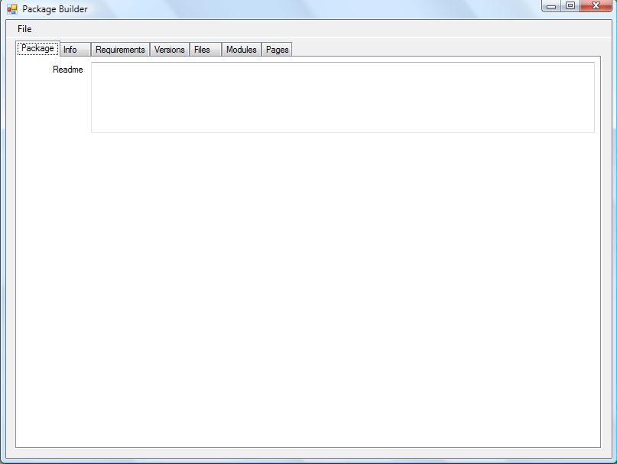

Slide 7
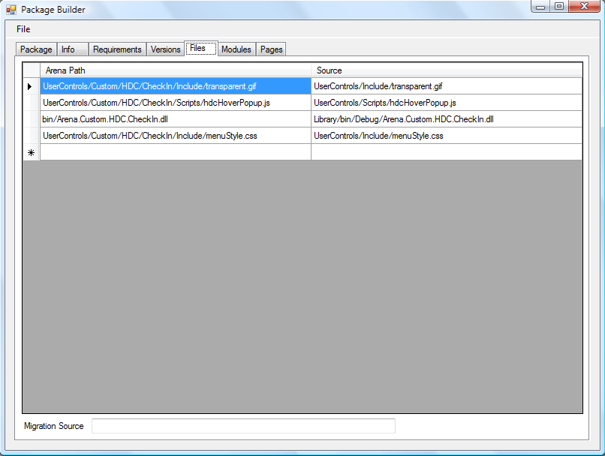

Slide 8
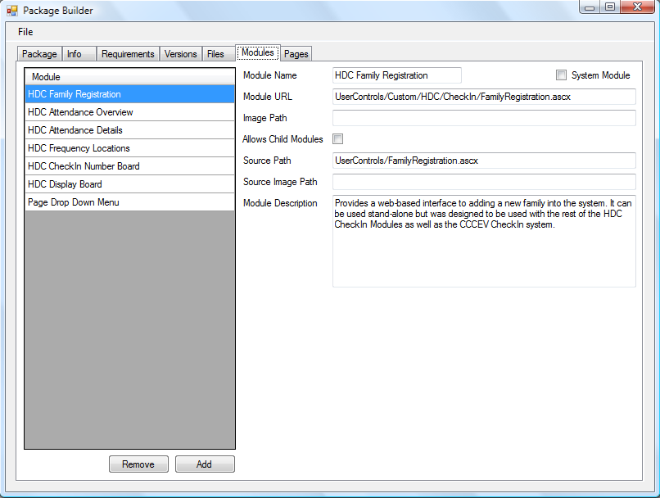

Slide 9
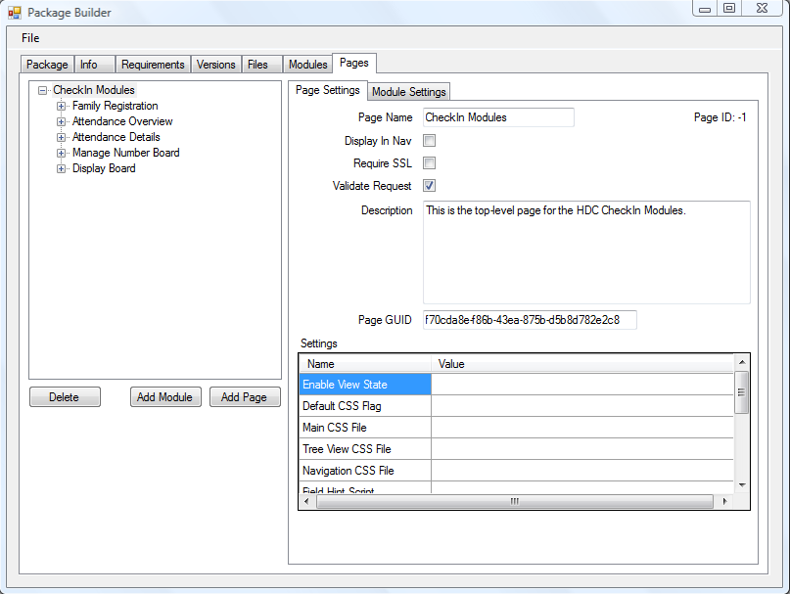

Slide 10
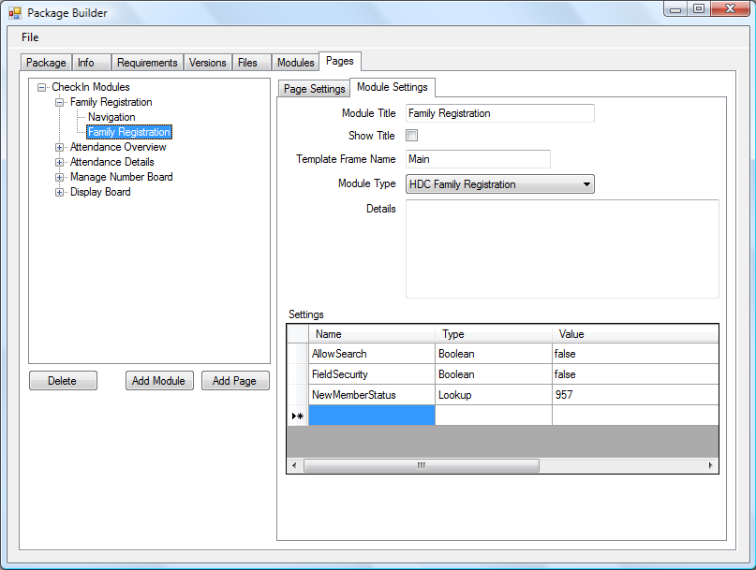

Slide 11
Package Builder 2.0
That builds a package for the current distribution system, what about the future?

Slide 12
Difficulties for the Developer
A developer must get their custom modules fully installed and functioning on an Arena installation.
You have to prepare all the SQL scripts.
Then you must export the custom modules as a new page.xml, requiring you to add all supplemental files needed one at a time without forgetting anything.
After that you have to find a different Arena installation that you can test this page.xml on to make sure that you remembered to include all the files, set the right paths, have the right module settings, etc. If anything is wrong you have to begin all over.
Finally you can upload your page.xml to the community server and announce that it is ready and hope everybody can find the correct version.
Difficulties for the End-User
As an end-user wanting to install the custom modules you have to find the latest version of the modules you want.
Download them and extract the package bundle.
Run the SQL installer script(s) on the Arena server, remembering to run them against the correct database.
Then you have to upload the page.xml into Arena. At that point you should have a working installation.
When you are ready to upgrade your version of Arena you have to call around and find out if it is going to break any custom modules or just try the upgrade and hope for the best.

Slide 13
Difficulties for the Developer
A developer must get their custom modules fully installed and functioning on an Arena installation.
You have to prepare all the SQL scripts.
Then you must export the custom modules as a new page.xml, requiring you to add all supplemental files needed one at a time without forgetting anything.
After that you have to find a different Arena installation that you can test this page.xml on to make sure that you remembered to include all the files, set the right paths, have the right module settings, etc. If anything is wrong you have to begin all over.
Finally you can upload your page.xml to the community server and announce that it is ready and hope everybody can find the correct version.
Difficulties for the End-User
As an end-user wanting to install the custom modules you have to find the latest version of the modules you want.
Download them and extract the package bundle.
Run the SQL installer script(s) on the Arena server, remembering to run them against the correct database.
Then you have to upload the page.xml into Arena. At that point you should have a working installation.
When you are ready to upgrade your version of Arena you have to call around and find out if it is going to break any custom modules or just try the upgrade and hope for the best.

Slide 14
Package Builder 2.0
What comprises a package?
Support Files
Modules
Pages
Database Upgrades
Dependency Injection
Changelog

Slide 15
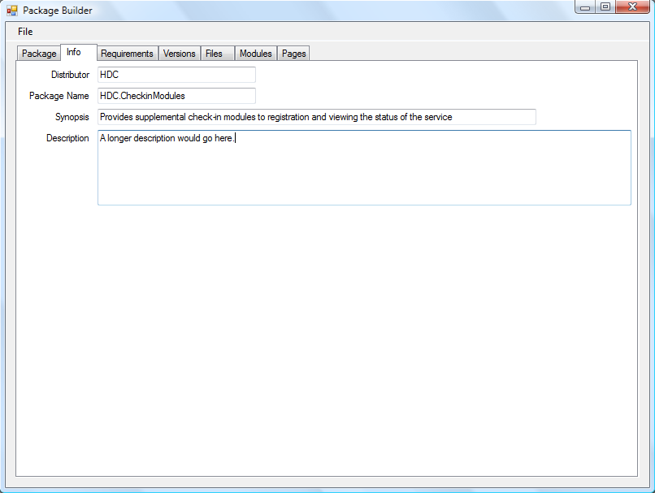

Slide 16
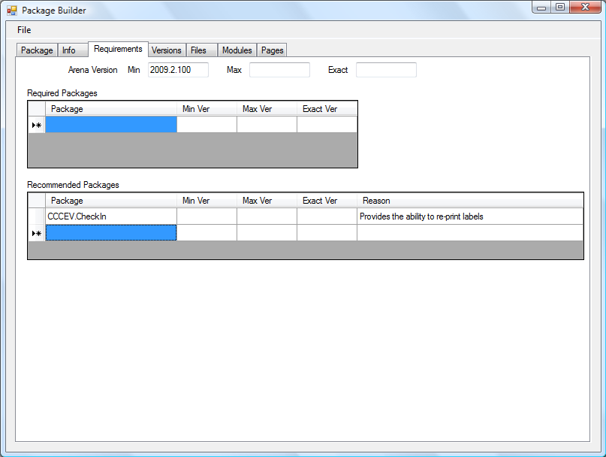

Slide 17
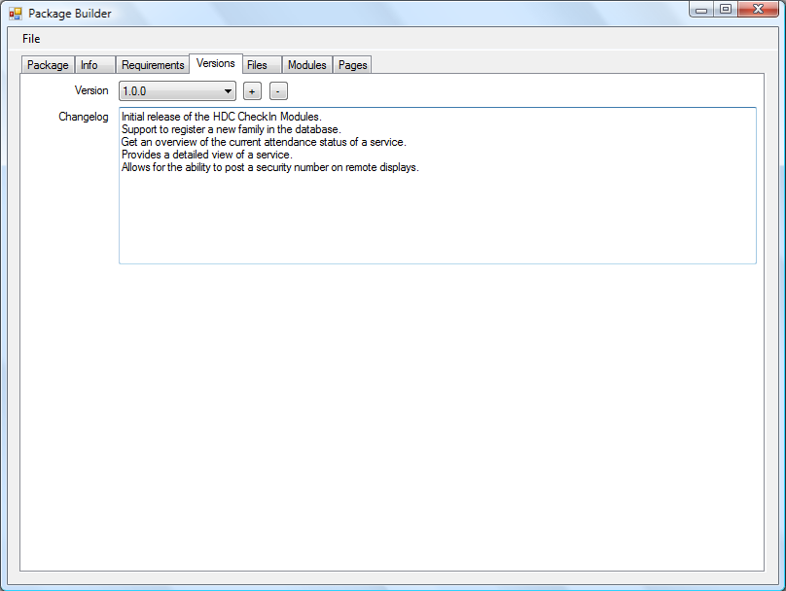

Slide 19



Package Builder 2.0
That is a lot to prepare
User Controls
Core Logic
Database Migrations

Slide 20

Package Builder 2.0
How do we simplify creating all of this?
We automate it!

Slide 21
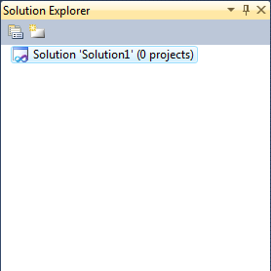
Package Builder 2.0

Slide 22
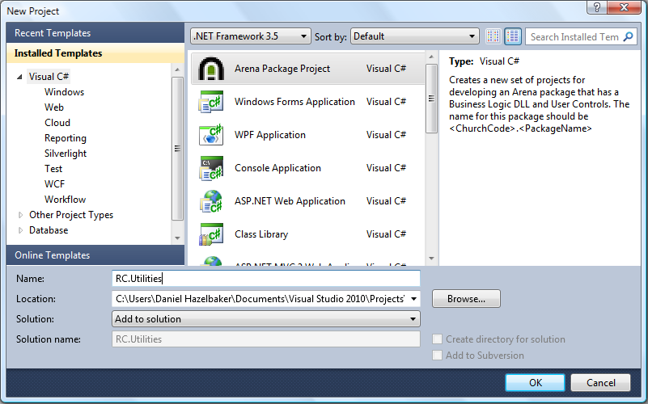

Slide 23
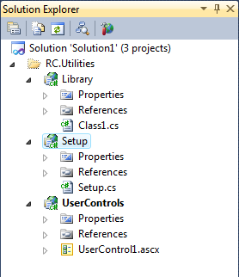
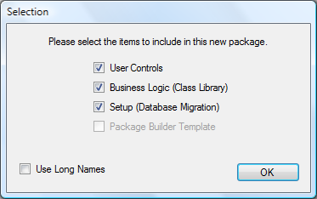
Package Builder 2.0

Slide 24
More Resources
Docs - http://redmine.refreshcache.com/projects/refreshcache/wiki/Package_Builder
Download - http://redmine.refreshcache.com/projects/refreshcache/files

